Slide 1
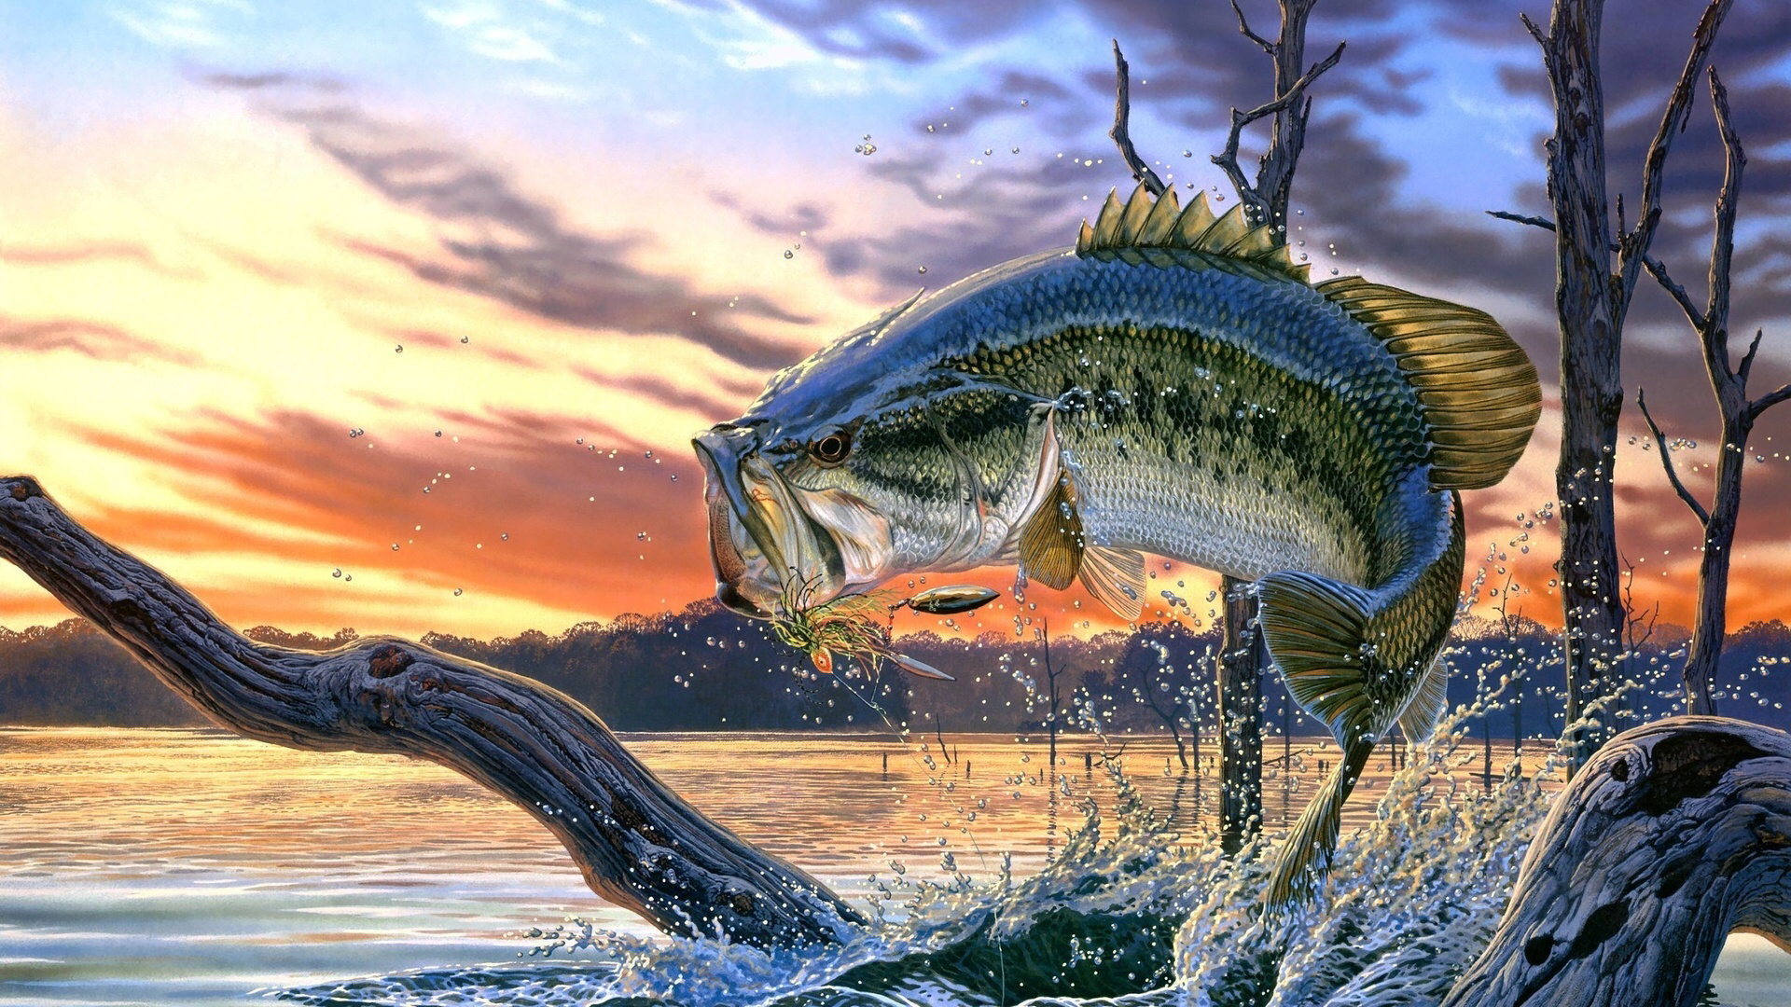
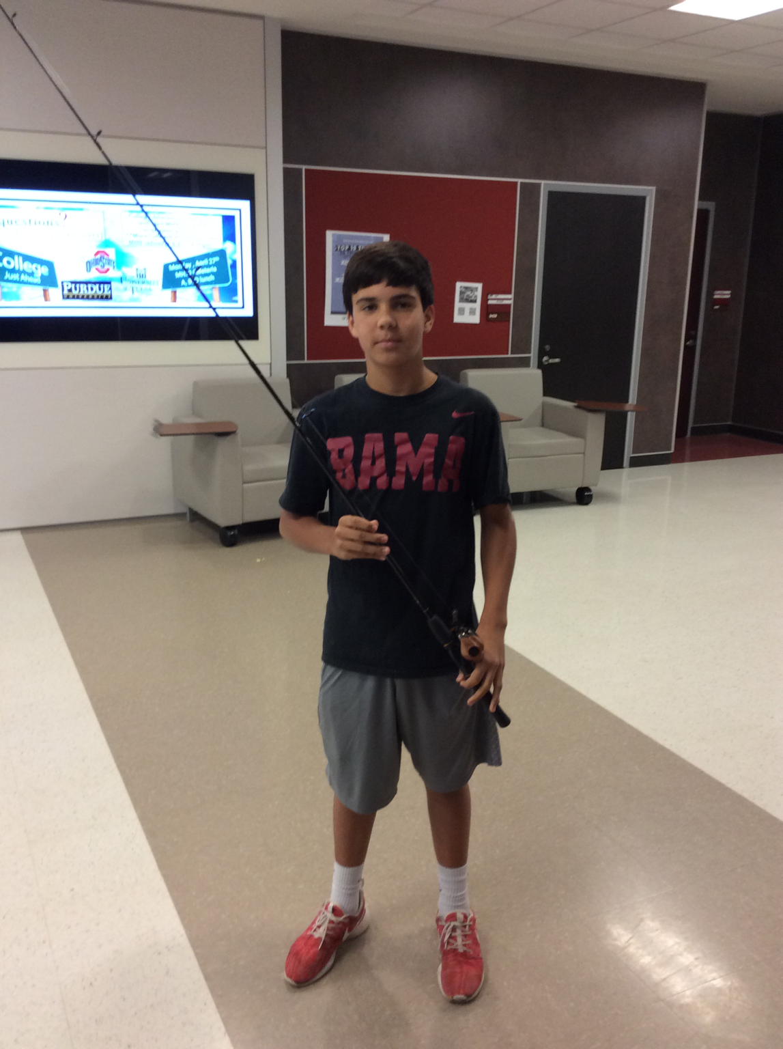
Fishing for Algebra
By: Jacob Roich and Thien

Slide 2
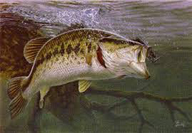
Reel Speed Equation
y=4x

Slide 3
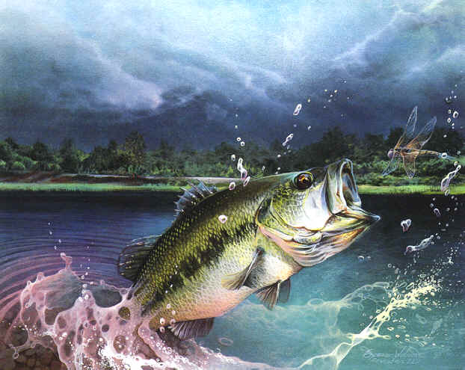
Fishing Reel Speed Ratio
Ratio or Rate of Change means for every handle turn, how many times does the spool turn. For example my reel has a 4/1 ratio. That means for every handle turn, the spool turns 4 times.

Slide 4
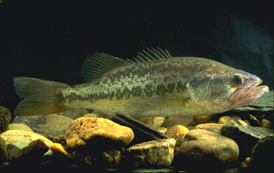
The Domain and Range Variables
The domain variable is what represents the handle turns, while the range variable represents the spool turns.

Slide 5
The Y-Intercept
The y intercept is what y is equal to when x equals zero, or where the line hits the y axis.

Slide 6
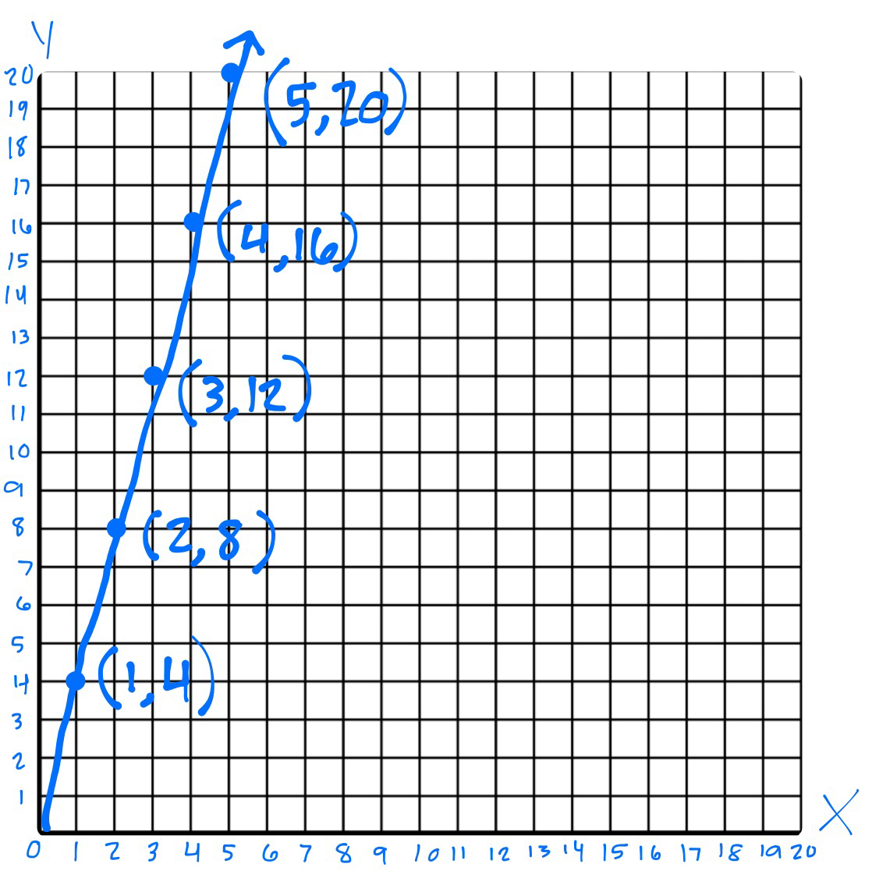
Linear Graph of Reel
Spool Turns
The x axis represents how many times the handle turns. The y axis represents how many times the spool turns
Change in Y = 4
Change in X = 1
Handle Turns

Slide 7
Table of Values
X | 1 | 2 | 3 | 4 | 5
Y | 4 | 8 | 12 | 16 | 20
y= 4x
The Input Variable is the change in x. The Output Variable is the change in Y.
M= 4
1

Slide 8
New Situation
For every pitch Jacob throws he has to ice his arm for half a minute. If Jacob throws 80 pitches how long will he have to ice his arm?
Equation
Y= .5x

Slide 9
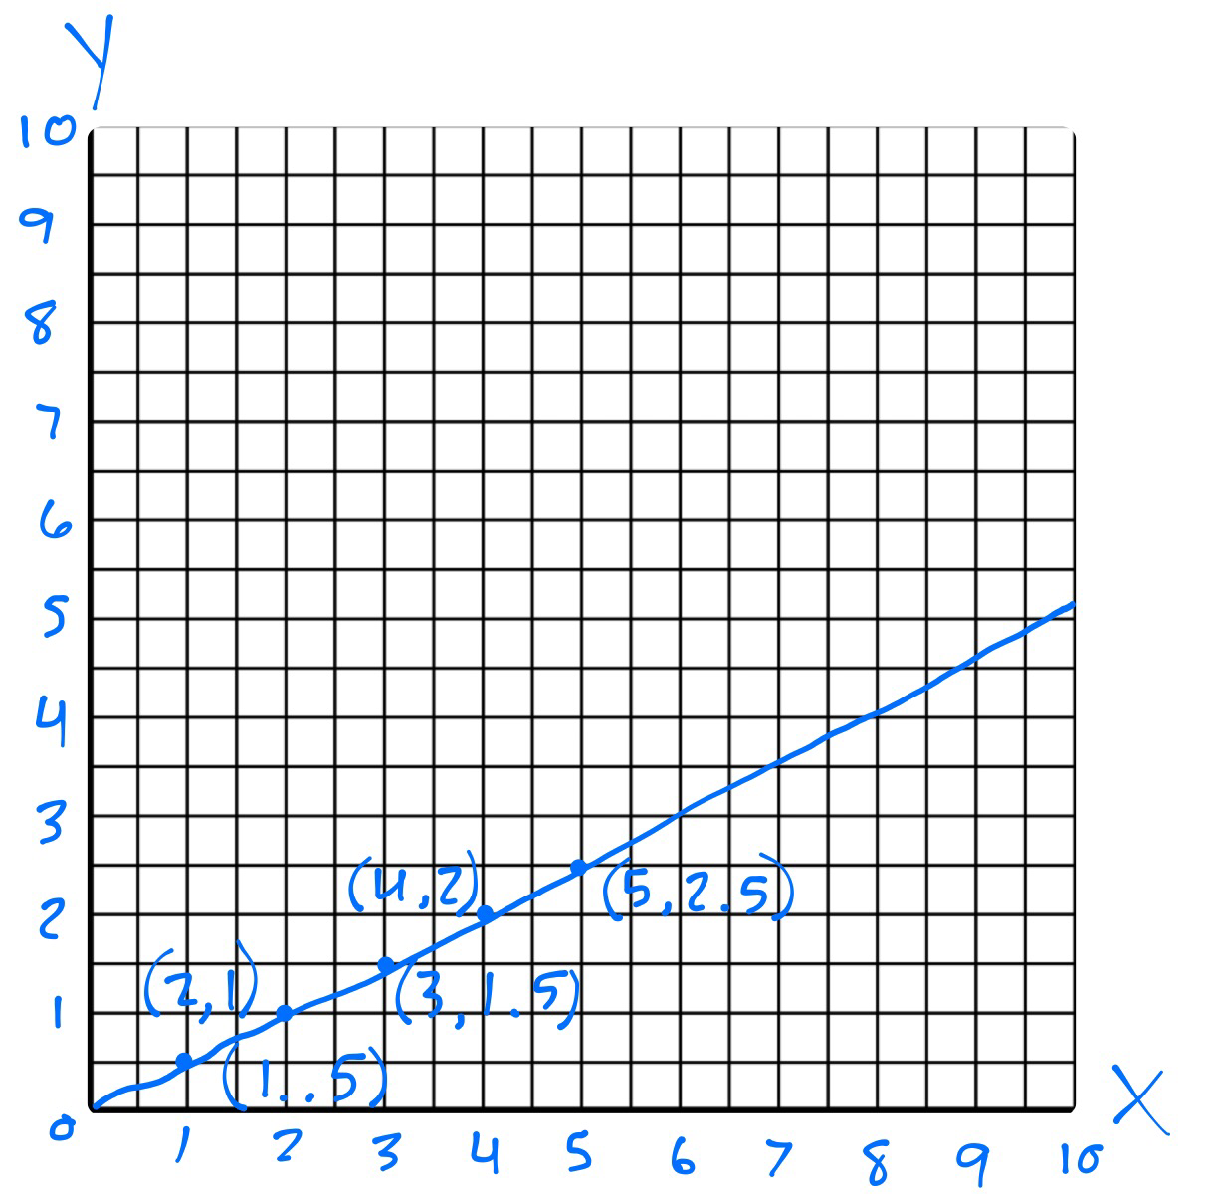
Minutes Jacob's Arm was Iced
Pitches Thrown

Slide 10
X | 1 | 2 | 3 | 4 | 5
Y | .5 | 1 | 1.5 | 2 | 2.5
M= .5
1

